Slide 1
Synopsis for Final Year Project “Deep Learning Based Detection of Depression”
Project Team Guide
Akshay Suryanarayan Hegde Prof. Ashritha R. Murthy
Ganesh S
Aniket Kharad
Manzoor Ahmed

Slide 2
Introduction
Depression is a mental health disorder characterized by persistently depressed mood or loss of interest in activities, causing significant impairment in daily life.
It is important to find depression because, according to WHO over 300 million people suffer from different kinds of depression and depressive symptoms.
Depressive disorder is mainly seen in the age group of 20-40.
The existing ways to find a depression are through text, images, speech and video, social media has proven to be a powerful tool to detect depression.
Hence we came up with the title “Deep Learning based detection of Depression”.

Slide 3
Feasibility Study and Requirements
Feasibility study is classified into two types :-
Technical Feasibility
Financial Feasibility
Requirements are classified as two types :-
Functional Requirements
Non Functional Requirements.

Slide 4
Literature Review
Jana M. Havigerova et.al proposed an unique feature from the text based analysis, the author found out that people suffering from depression tend to use some peculiar semantic linguistics that is they use second person singular to address a person and use quantifiers of extreme poles like “never”, “everything” etc. Some of the second person singular is “I”, “We” etc. Making use of this peculiar feature of Text the author has proposed various models.
Thirteen linguistic variables (6 single morpho-syntactic characteristics, 7 indexes combining more morphosyntactic characteristics) were included into the predictive models. Eight predictive models (for 4 different texts and 2 genders) were created and compared with each other. Author has considered gender depression for the purposes of analyzing the models and specifies there are different symptoms based on the gender.

Slide 5
Dataset
There are two ways of getting the dataset
Scraping the social media websites to get the comments from the users using scraping tools like TWINT etc.
Standard Dataset/ Readily available dataset from Kaggle.
Ex :- ISEAR,EMOBANK

Slide 6
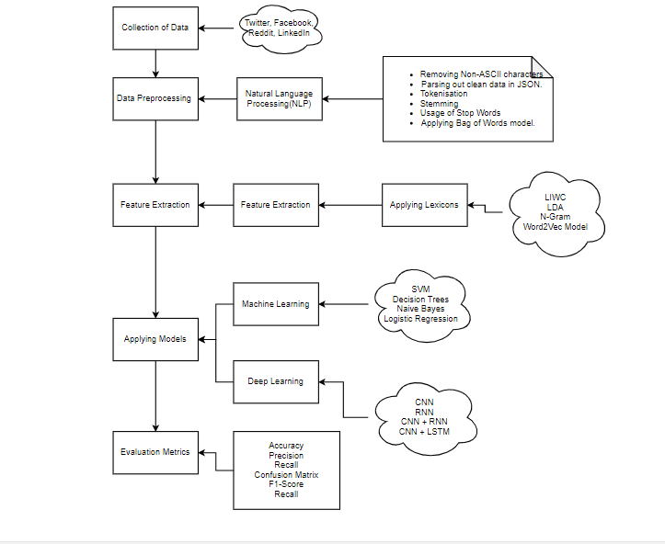
Architecture

Slide 7
Natural Language Processing
Parsing out clean data in JSON
Removing non ASCII characters
Tokenisation
Stemming
Removing of the Stop Words
Applying Bag of Words model
Feature extraction steps

Slide 8
Feature Extraction
Word2Vec Model
Shallow Neural Network with 2 layers.
Group of related models used to produce word Embeddings.
Word2Vec Model has makes use of 2 types of architectures
CBOW(Continuous Bag of Words)
Skip-gram

Slide 9
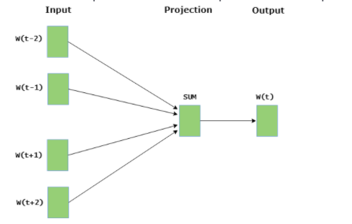
CBOW
CBOW model predicts the current word given context words within specific window.
The input layer contains the context words and the output layer contains the current word. The hidden layer contains the number of dimensions in which we want to represent current word present at the output layer.

Slide 10
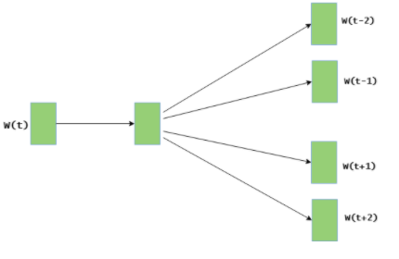
Skip-gram
Skip gram predicts the surrounding context words within specific window given current word.
The input layer contains the current word and the output layer contains the context words. The hidden layer contains the number of dimensions in which we want to represent current word present at the input layer.

Slide 11
Word Embeddings
It is an approach for representing words and documents It allows words with similar meaning to have a similar representation.
A word can be represented in terms of a vector where length of the vector means the attributes present in a word.
If size of vector is 50 then the word is judged based on 50 features.
To reduce dimensionality
To use a word to predict the words around it
Inter word semantics must be captured

Slide 12
ML/DL model
Applied a Logistic Regression Model as a preliminary model. Keeping the this model as a base model we can evaluate other models.
Applied basic CNN algorithm as an extension to the model.
Various Machine Learning models like Decision Tree, SVM, Naïve Bayes can be applied with k-fold cross validation for better accuracy and performance.
Further we can apply Deep Learning models like CNN, CNN + LSTM, RNN, Hybrid Neural Networks on top of that we can have Hyperparameter tuning to improve the performance of the model.
There are different accuracy metrics which can be taken into consideration such as precision, recall, F1-score,AUC,ROC etc.

Slide 13
Thank You

